Slide 1




Pera Sparkers
100 % Accuracy in Credit
Risk Prediction and Breakthrough in
Risk Scoring
Presented by:
S. Thushan
G. Sathushana
R. Thivajini

Slide 2







Over View
01
02
03
Introduction
Method
Results
04
05
06
Discussion
Conclusion
Acknowledgement

Slide 3




Introduction
Financial institutions face challenges from borrowers who cannot repay debts and from fraud that exploits weaknesses in the lending system. These issues can lead to serious emotional and financial consequences for both the institutions and the individuals involved.
Over the past few years, the financial institutions has experienced a sharp increase in the number of charged - off accounts.

Slide 4

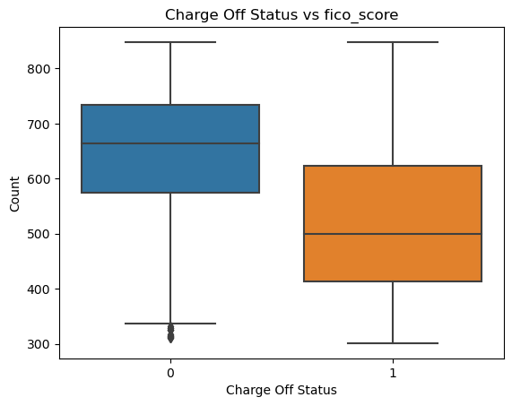



Currently they use traditional financial ratios and FICO scores to detect the fraudelant activities but that is insufficient to make suitable decisions.
We want to create a model that assigns credit risk score between 0 and 1000.
Based on these values credit officers guides their decision making on whether to approved or not.

Slide 5
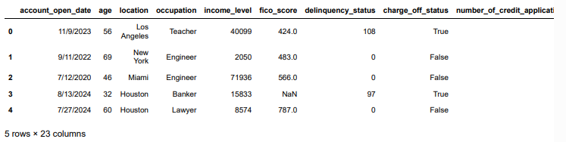
About dataset
For this purpose we use fraud_detection_dataset.csv which contains 7000 observations and 23 columns.

Slide 6

Methods

Slide 7

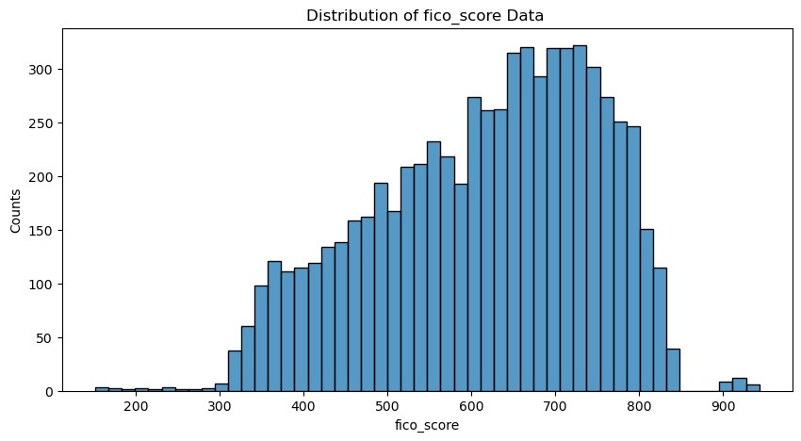
Handling Missing Values
In the given dataset FICO_Scores, avg_balance _last_12_months, number_of delinquent_accounts and unusual_submission_pattern have missing values.
- FICO Scores

Slide 8
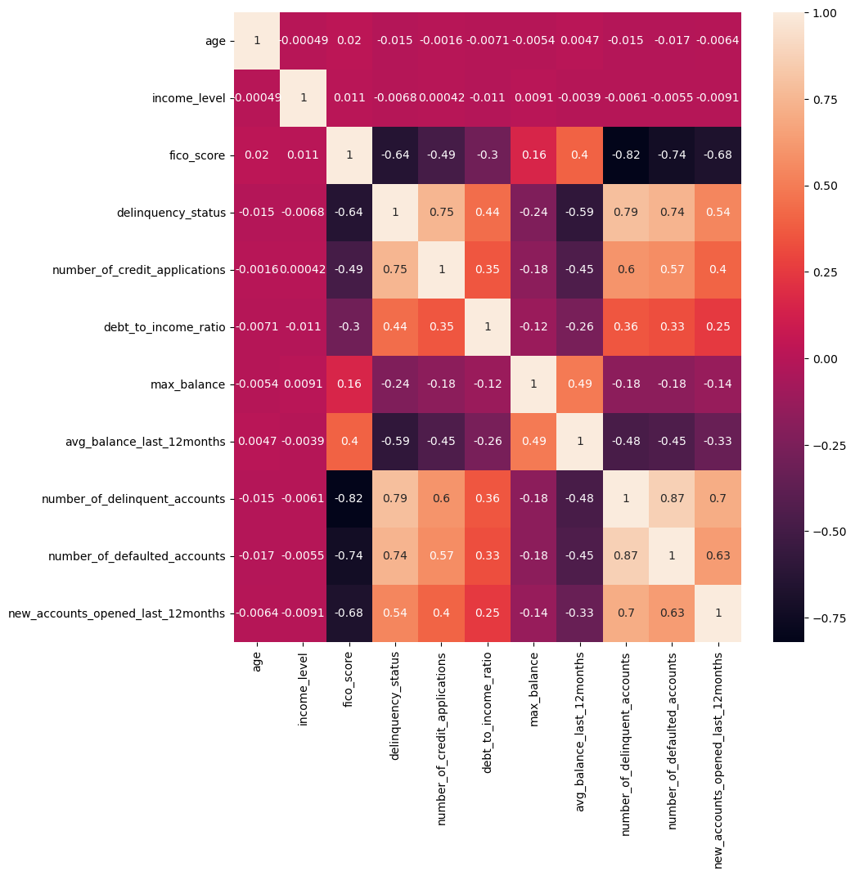
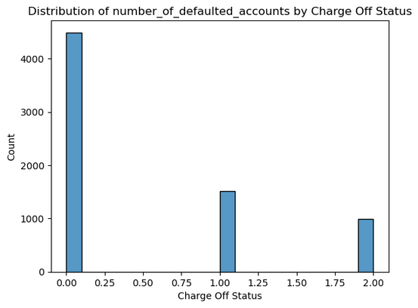
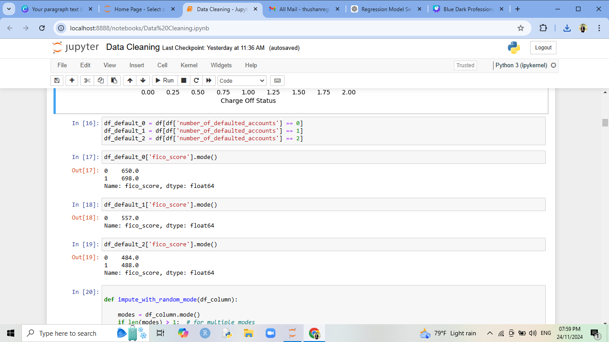
grouped the fico_score column by the number_of_defaulted_accounts For each group.
imputed the missing values in fico_score using the mode of respective group.

Slide 9
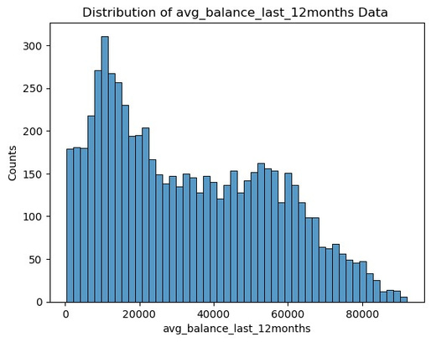
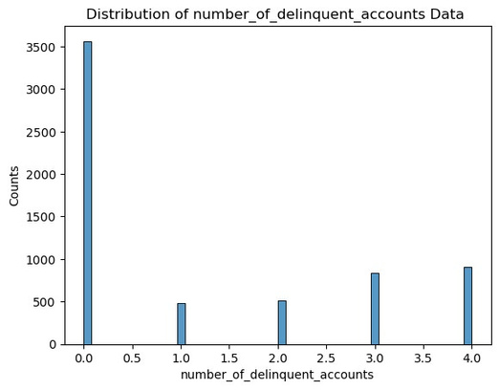
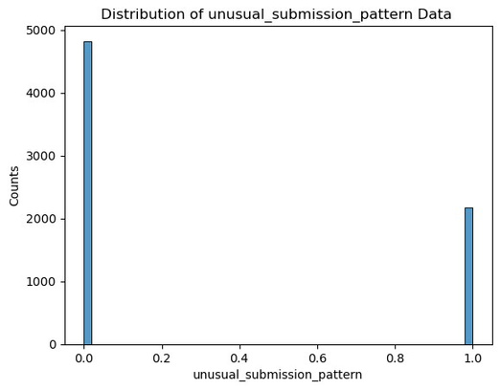
- Avg_balance_last_12_months and Number_of_delinquent_accounts
- Unusual_submission_pattern
used K-Nearest Neighbors method to imputation to these three.

Slide 10

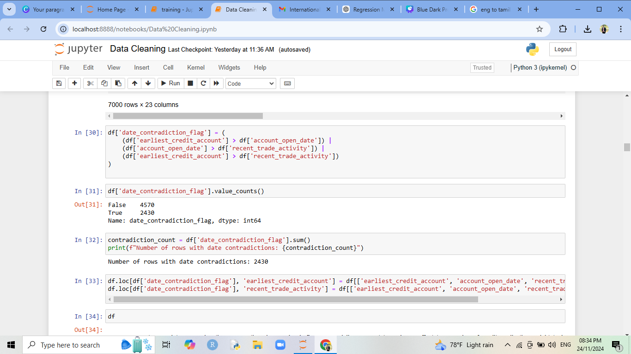
Resolving Contradictions
introduced a new variable called date_contradiction_flag to identify rows where the dates violated their proper chronological order.
adjusted the earliest_credit_account to the earliest date among the three columns and adjusted the recent_trade_activity to the latest date among the three columns.

Slide 11
Handling Outlier
- 'income_level'
Outlier analysis for income levels was performed by dividing the dataset based on charge-off status
(0 and 1).
Income levels were further grouped by location and occupation to account for the influence of
these factors on income distribution.

Slide 12
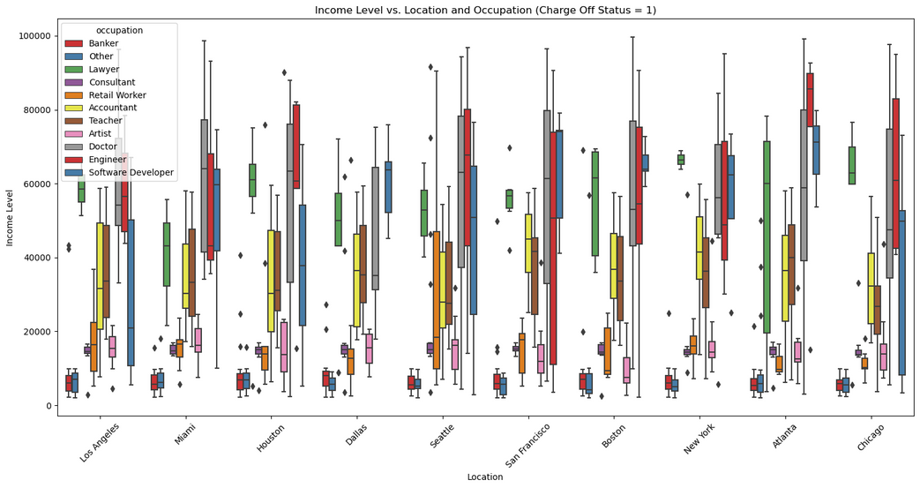
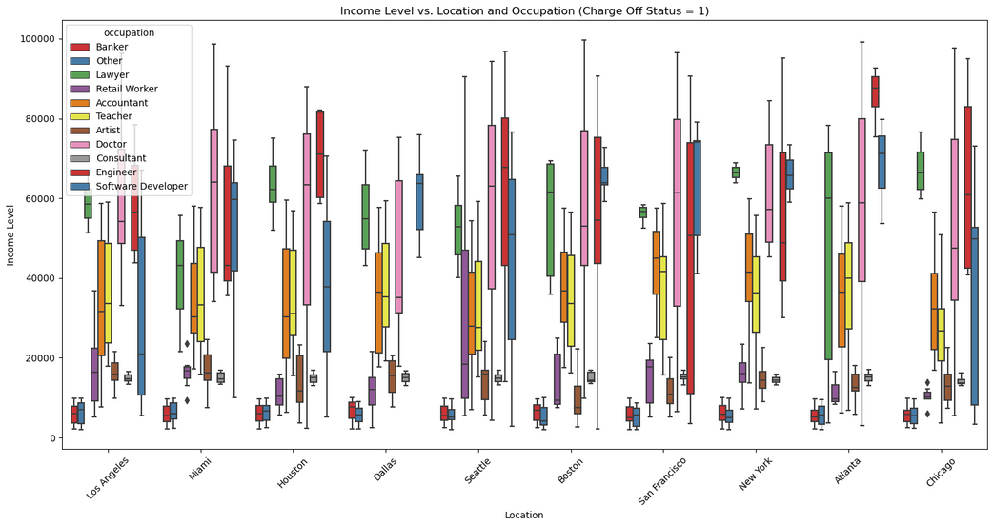
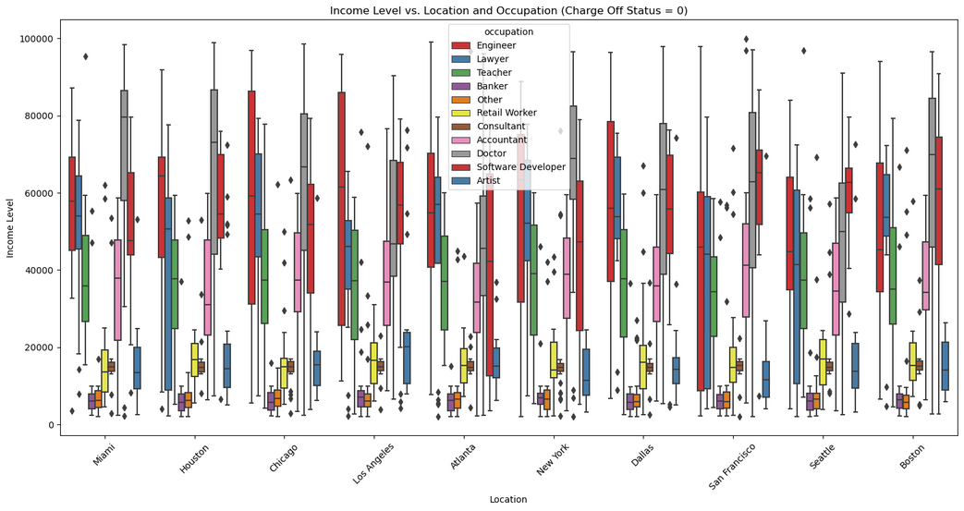
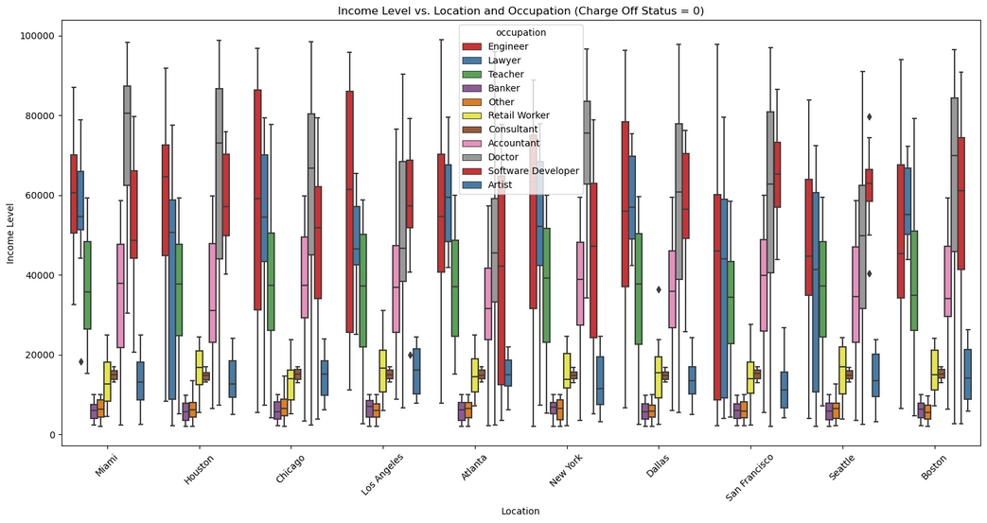

Slide 13
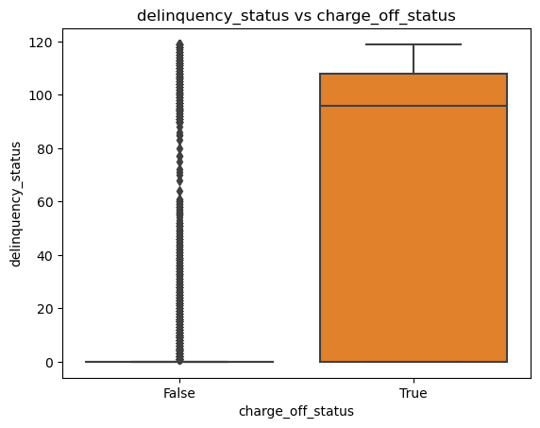
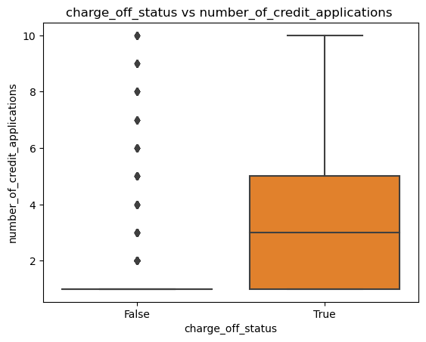
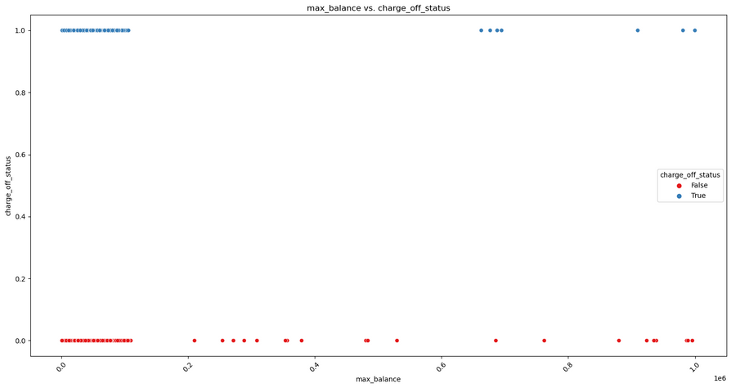
- 'FICO score'
Outliers in the FICO score variable were removed based on its valid range.
A log transformation was applied to reducing the impact of outliers on the analysis.
- 'delinquency_status’, 'number_of_credit_applications' and 'max_balance'

Slide 14
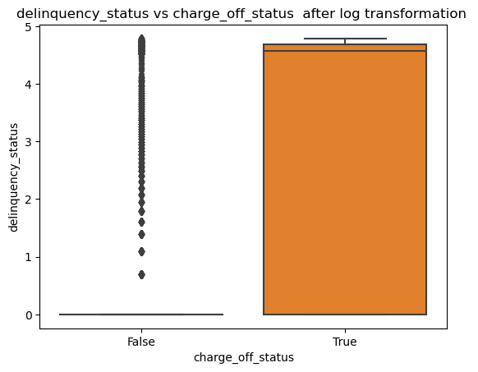
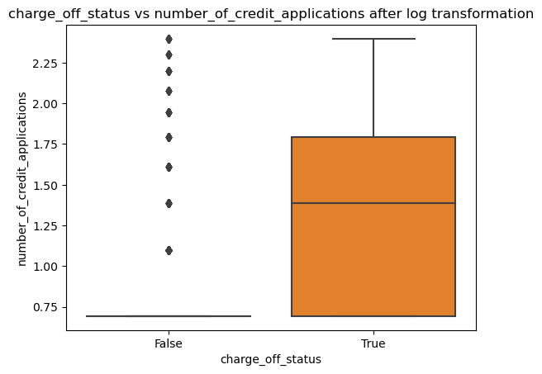
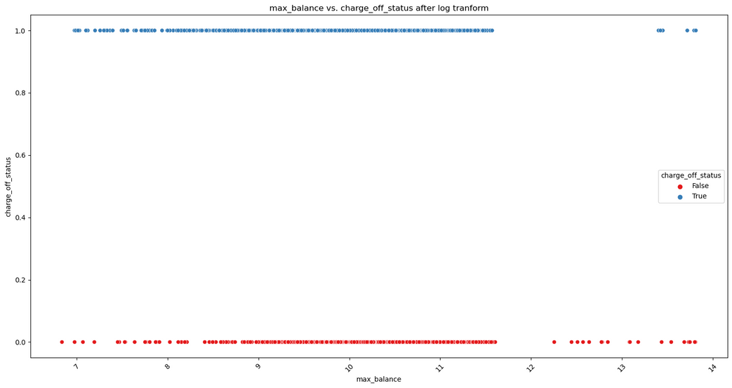
After log Transformation

Slide 15
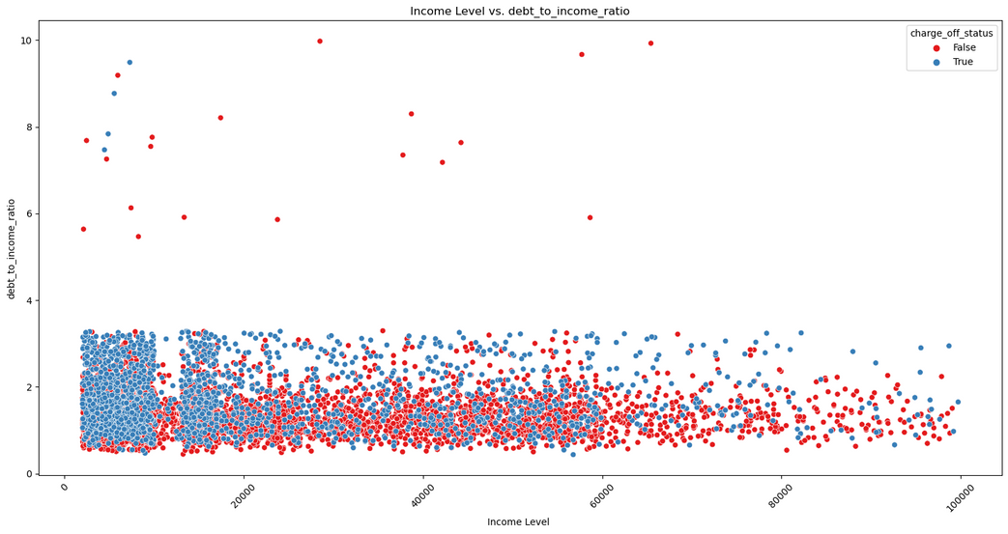
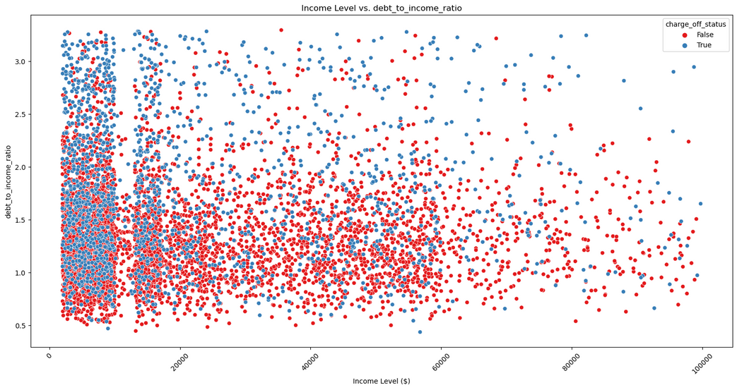
- ’debt_to_income’
Observed a cluster of outliers with debt_to_income ratios greater than 4,
Rows with debt_to_income values greater than 4 were removed to eliminate extreme cases.

Slide 16
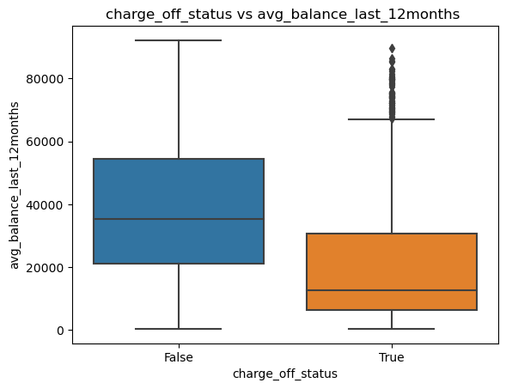
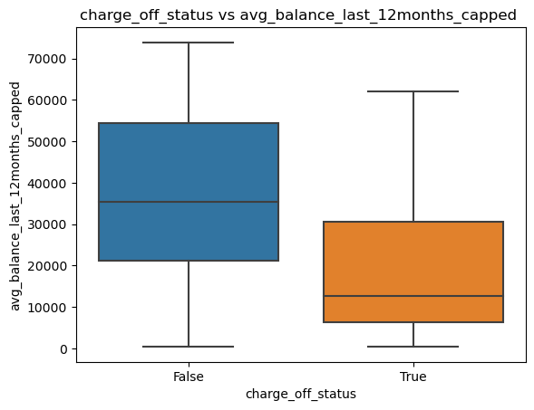
- ’avg_balance_last_12months’
Outliers in the avg_balance_last_12months were identified. A capping approach was applied For each charge-off status group.

Slide 17
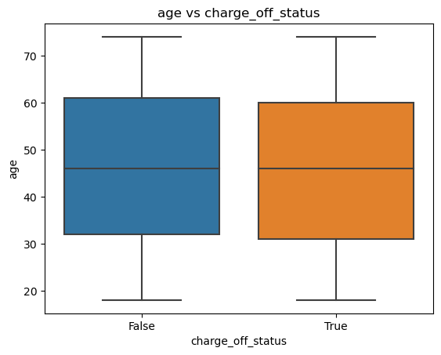
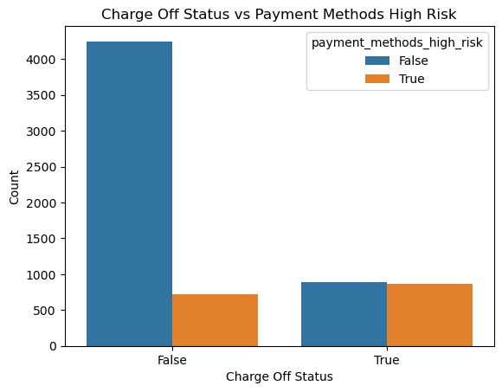
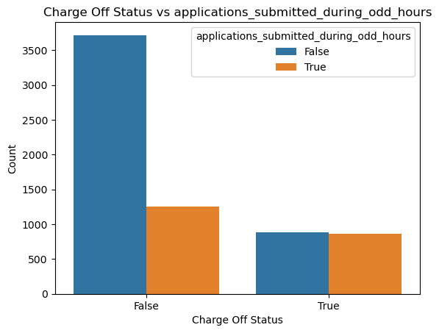
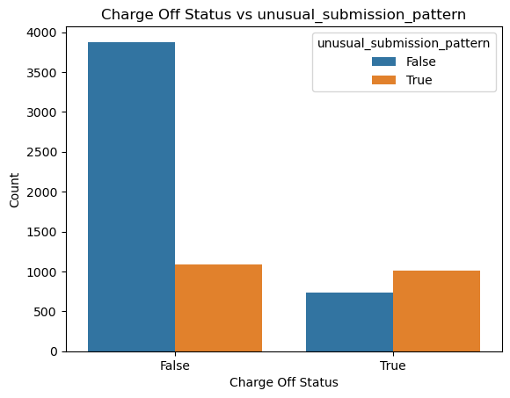
Remaining Variables

Slide 18
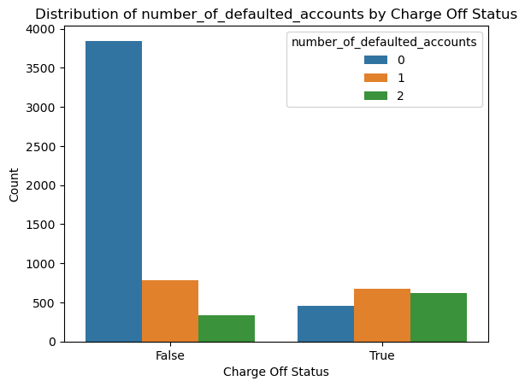
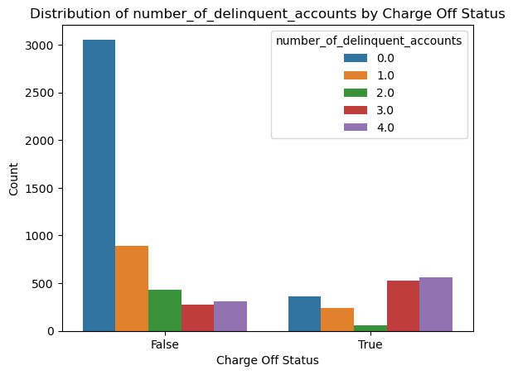
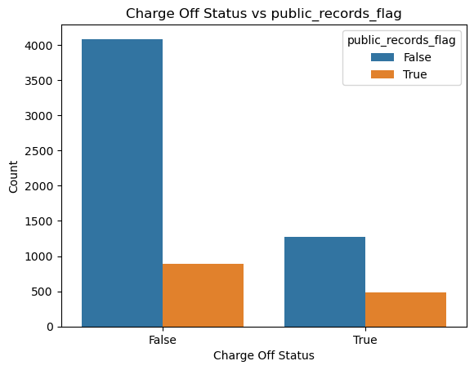
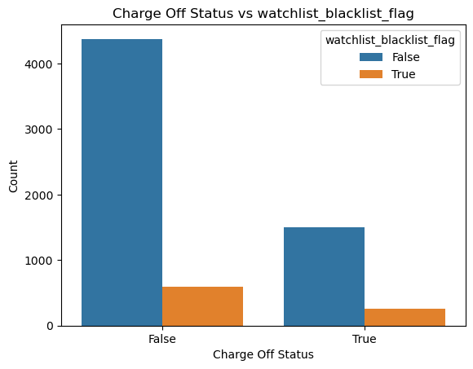

Slide 19
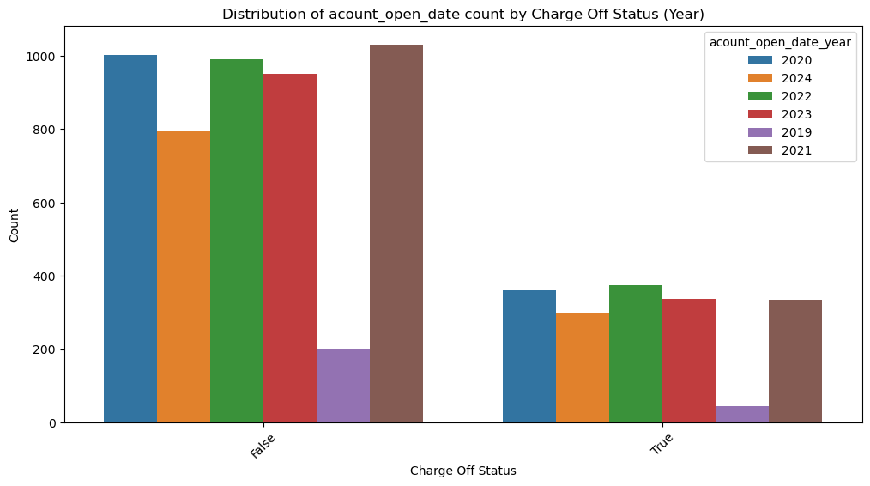
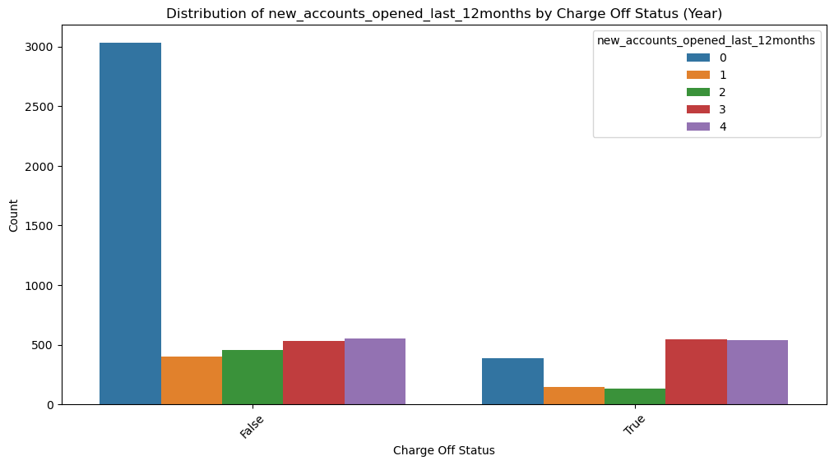

Slide 20
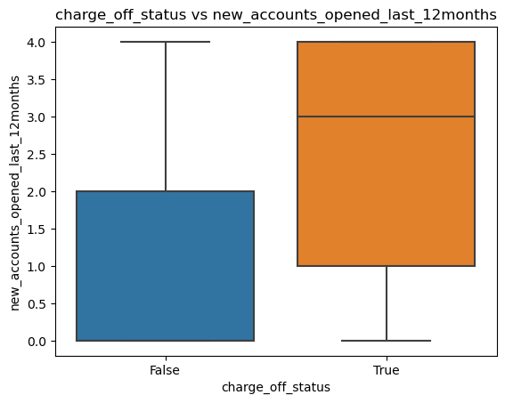
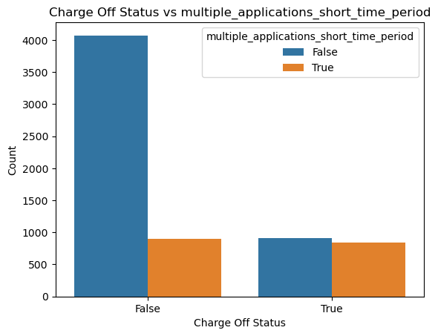
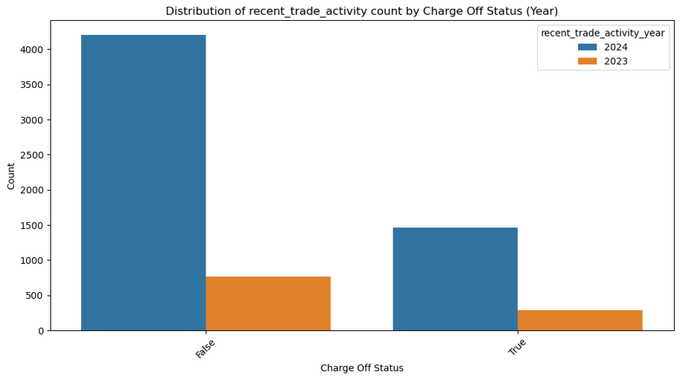

Slide 21
Method of Risk Scoring
Step 1: Understanding Variable Importance via Correlation
Step 2: Allocating Scores to Variables
| ρi |= Absolute Value of Correlation of i th Variable
Total Correlation= ∑(| ρi |)
Allocated Score of i th Variable= | ρi | / ∑(| ρi |) * 1000
Step 3: Scoring Numeric Variables
Normalized Value= (Value−Min)/(Max−Min)
For positively correlated variables
Score Contribution= Normalized Value × Allocated Score
For negatively correlated variables
Score Contribution= (1−Normalized Value)×Allocated Score

Slide 22
Step 4: Scoring category Encoded Variables
Adjustment= maximum Allocated score of category Encoding
For positively correlated variables
Score Contribution= Boolean Value × (Allocated Score - Adjustment)
For negatively correlated variables
Score Contribution= - Boolean Value × (Allocated Score + Adjustment)
Step 5: Scoring Boolean Variables
Score Contribution= Boolean Value × Allocated Score
Step 6: Final Score Calculation
Total Score= ∑ Score Contribution + ∑Total Allocated score of category Encoding

Slide 23
Method of Prediction
To select the best regression model for predicting risk scores, test multiple algorithms (Linear Regression, Ridge, SVM, etc.) using GridSearchCV with a range of hyperparameters for each model.
The best-performing models will be identified based on their scores, and parameters will be optimized.
Finally, the model with the highest score, simplicity, and interpretability will be chosen to ensure reliable predictions for the task.

Slide 24

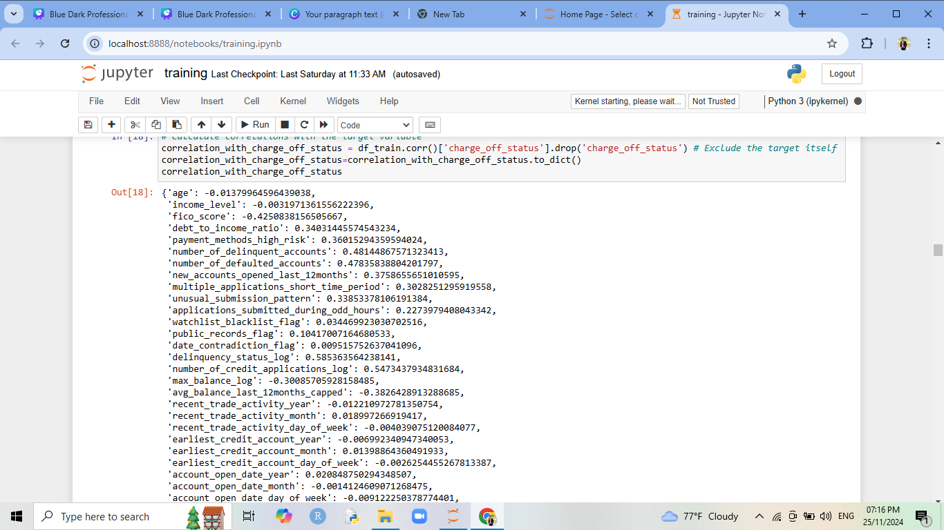
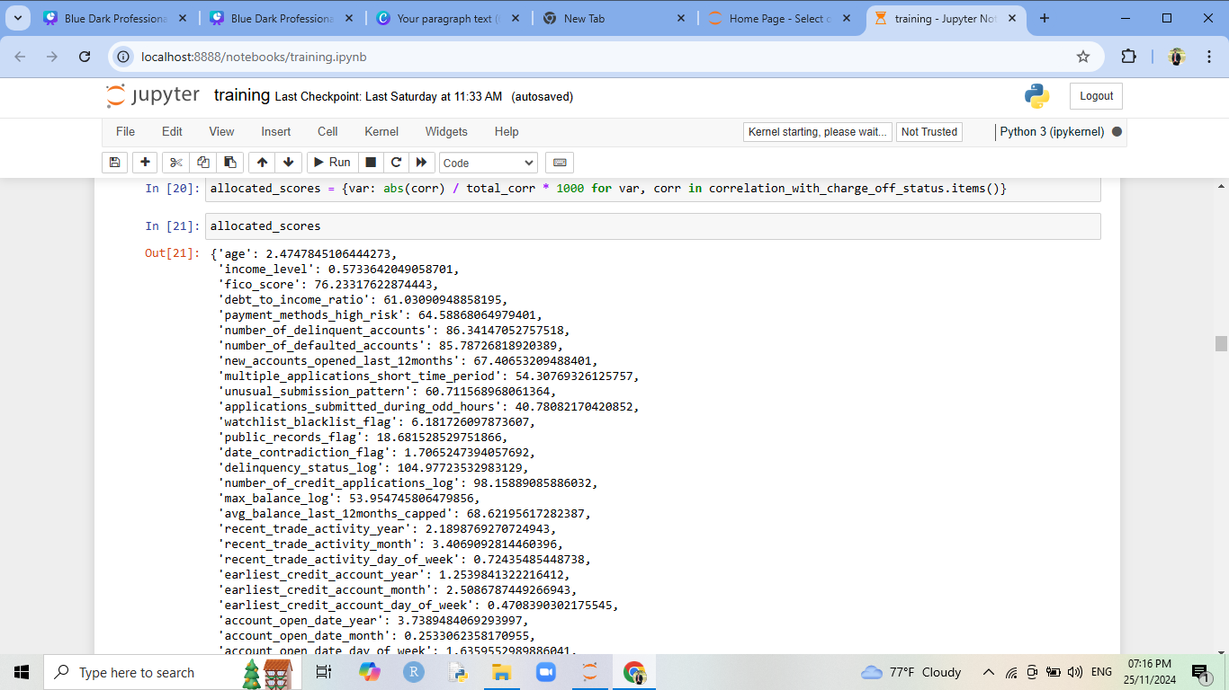
Results
Find the correlation between charged off status and other variables.
We can see that correlation between age, income level, FICO score and charged off status is negative and others are positive.
Total Allocated Score = 1000
Allocated Score

Slide 25
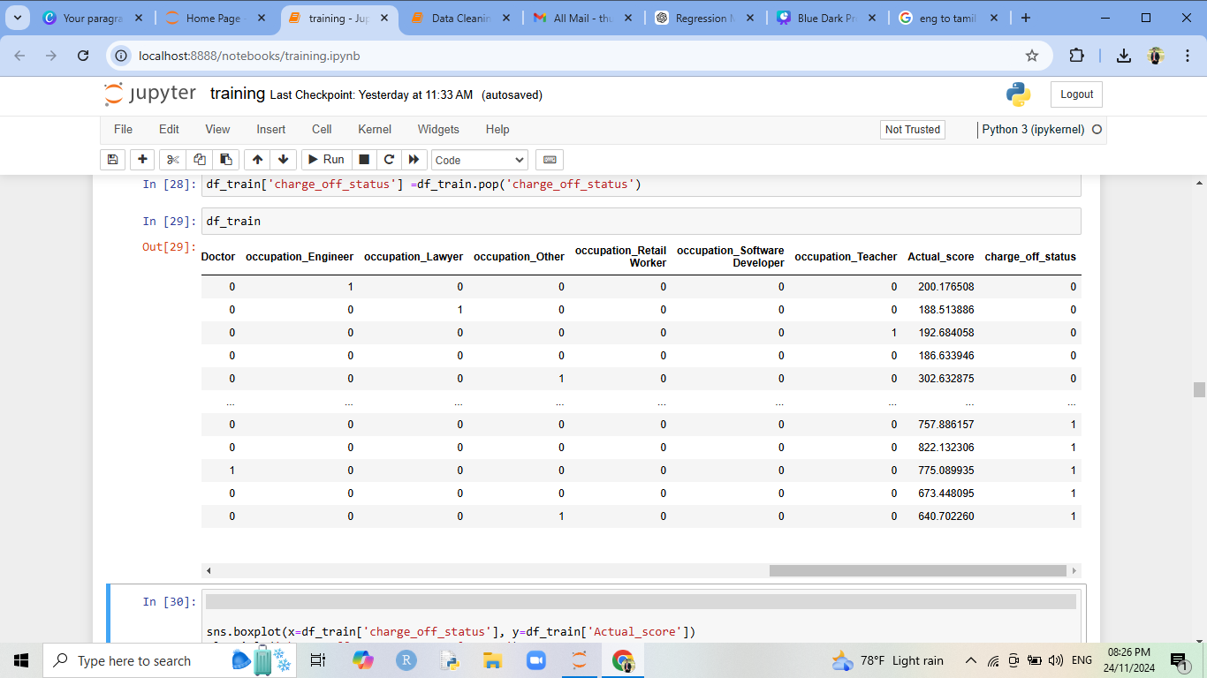
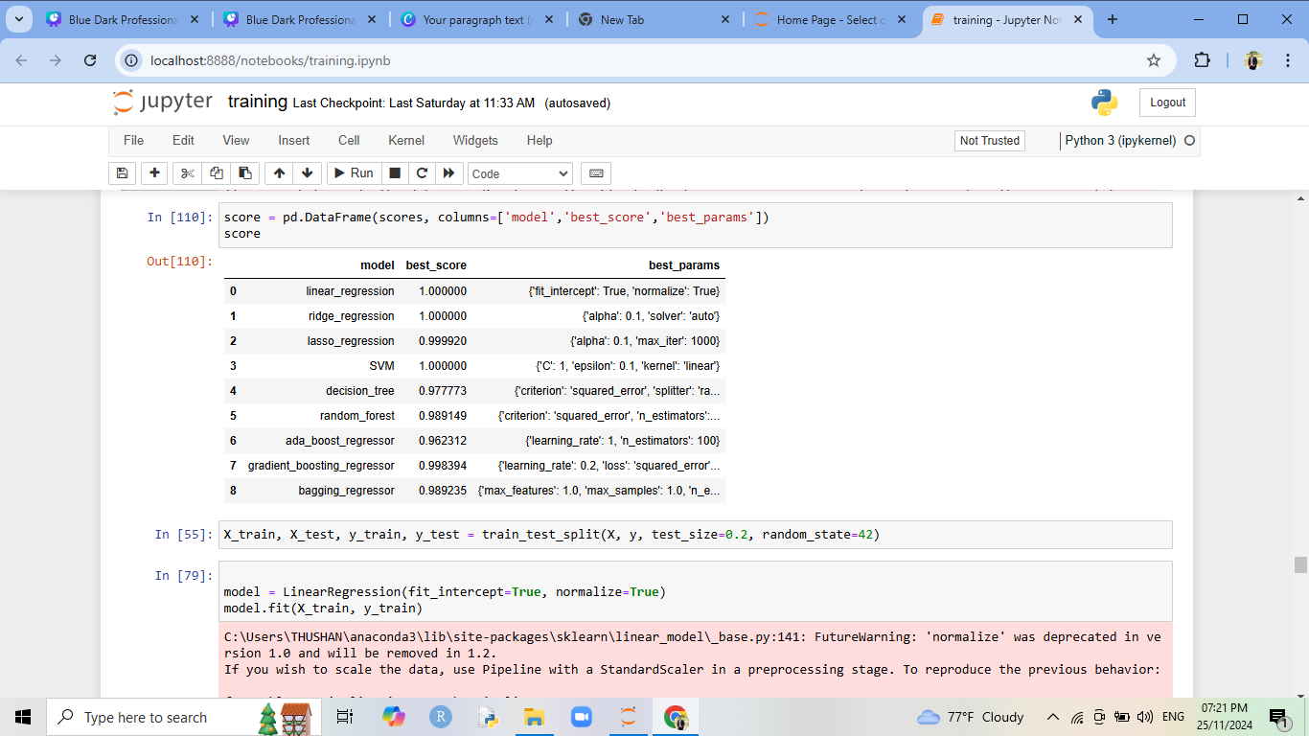
Credit Risk Score (Actual Score)
Model Comparison
Linear Regression, Ridge Regression, and Support Vector Machine (SVM) all achieved a perfect score of 1.000, indicating these models fit the data exceptionally well.
Among the machine learning models we use linear regression to predict the credit risk score.

Slide 26



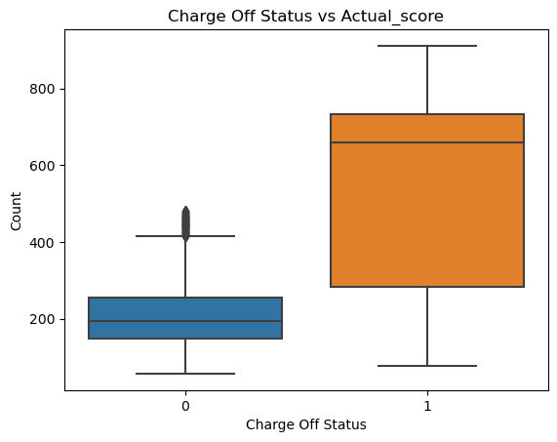

Discussion
We cannot get any clear decision about the charged off status when considering the FICO score because of two status get almost same range and overlapping.
Don’t have any overlapping and get different range.
If credit risk score greater than 481.97 we can confidently say that that is charged off accounts.

Slide 27
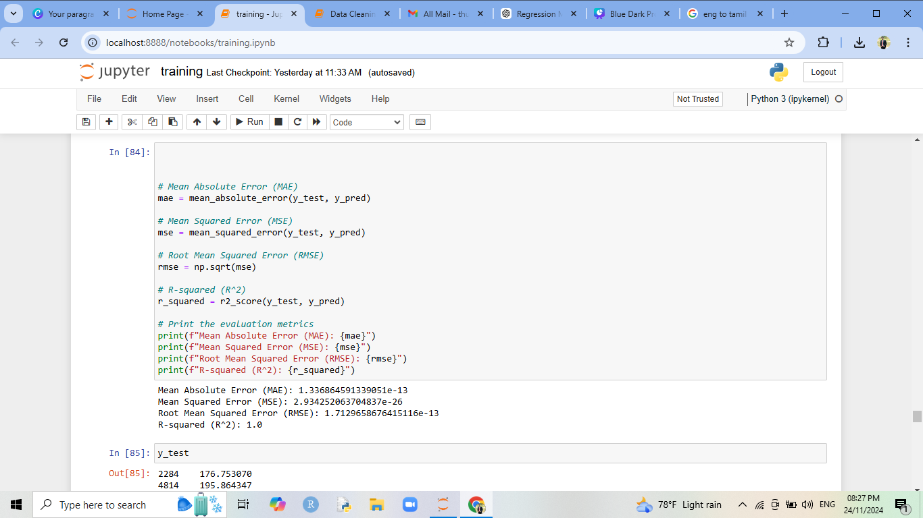
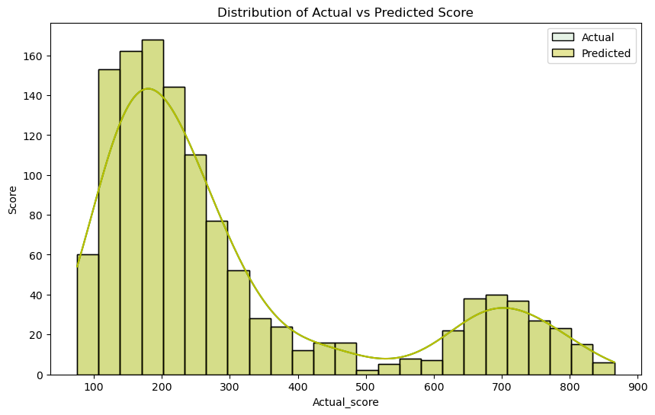
When we use linear regression
Indicates the model explains 100% of the variance in the target variable.
All predicted values perfectly match the actual values.
The difference between predicted and actual values averages to almost zero when squared and averaged.
From this you can see actual value and predicted values are coincided.
In here, we extend 48 columns for our simplicity, by using the PCA we can limit the variables to 40 columns.

Slide 28

Conclusion
Credit risk score prediction and fraud detection are critical components in ensuring the stability and reliability of financial systems.
In the Traditional FICO Score method, charged - off values are overlapping and we cannot get any clear decisions. So, we used credit score method.
Used mode imputation and KNN imputer to handle the missing values.
Outlier is handled using log transformation, capping and IQR methods.
We create a new variables as date_contradiction_flag to handled contradiction related to dates.
Linear Regression is applied to predict the credit risk score and our model achieved 100% accuracy.

Slide 29

Acknowledgement
We would like to express our heartfelt gratitude to everyone who contributed to the successful completion of this case study.
We thank to Institute of Applied Statistics, SriLanka (IASSL) for providing us with access to relevant data and resources that formed the backbone of this study.
Additionally, we thank our peers and colleagues for their constructive feedback and support during the preparation of this presentation.

Slide 30
“Risk Comes From not Knowing What you’re Doing”
Thank You

